Slide 1
Information Technology Project Management – Third Edition
By Jack T. Marchewka
Northern Illinois University
Copyright 2009 John Wiley & Sons, Inc. all rights reserved. Reproduction or translation of this work beyond that permitted in Section 117 of the 1976 United States Copyright Act without the express permission of the copyright owner is unlawful. Request for further information should be addressed to the Permissions Department, John Wiley & Sons, Inc. The purchaser may make back-up copies for his/her own use only and not for distribution or resale. The Publisher assumes no responsibility for errors, omissions, or damages caused by the use of these programs or from the use of the information contained herein.

Slide 2
Defining and Managing Project Scope
Chapter 5

Slide 3
Project Planning Framework

Slide 4
Scope Management Processes
Scope is the work boundaries and deliverables of the project
The boundary and deliverables that the project team will provide to the project sponsor
The scope boundary acts as a fence to ensure that what needs to get done, gets done – and only what needs to get done, gets done
What is part of the project and what is NOT
Performing work that does not help the project achieve its MOV needlessly consumes valuable time and resources

Slide 5
Scope Management Processes
Scope Planning
The development of a scope management plan that defines the project’s scope and how it will be verified and controlled throughout the project
Lays out the processes, tools and techniques to be used by the project team to define and manage the project’s scope
Scope Definition
A detailed scope statement that defines what work will and will not be part of the project and will serve as a basis for all future project decisions
Create Work Breakdown Structure
The decomposition or dividing of the major project deliverables (i.e., scope) into smaller and more manageable components
Scope Verification
Confirmation and formal acceptance that the project’s scope is accurate, complete, and supports the project’s MOV
Scope Control
Ensuring that controls are in place to manage proposed scope changes once the project’s scope is set. Must be communicated to all project stakeholders.

Slide 6
Scope Management Plan
The processes and techniques for defining and managing scope make up the scope management plan
The procedures for defining and managing the scope must be communicated and understood by all of the stakeholders to minimize the likelihood of misunderstandings
The scope must align and support the project’s MOV
The next slide summarizes the components and processes of a scope management plan

Slide 7
Scope Management Plan
Scope
Planning
Scope
Definition
Create
WBS
Scope
Verification
Scope
Control
Documents how the team will define and develop the project’s scope and WBS, as well as processes for verifying and controlling the project and product deliverables.
Builds upon the preliminary project scope statement to define all the project and product deliverables, including the processes and criteria for acceptance.
A project planning tool that that decomposes or subdivides and organizes the project’s scope into a deliverable-orientated hierarchy.
A formalized acceptance from the appropriate stakeholders that the defined project scope is complete
A defined process for managing changes to project and product scope and the impact of those changes to the project’s schedule and budget.
Scope
Management
Plan
Detailed
Project
Scope
Work
Breakdown
Structure
Scope
Verification
Checklist
Scope
Change Control
Process

Slide 8
Scope Planning
Initiating process to begin defining and documenting the project work (i.e., deliverables) needed to achieve the project’s MOV
Extra work that will not help the project achieve it’s MOV will only needlessly increase the project’s schedule and budget
This process begins at a high level and will become more detailed as the project progresses and more information becomes available
Attempts to answer the question: What is and what is not to be delivered by this project?
Need to know what work is to be done in order to estimate time and cost
Makes the project sponsor’s needs and expectations explicit
Tools:
Scope Boundary
Scope Statement

Slide 9
Scope Boundary

Slide 10
Scope Statement
To define the scope boundary, create a more detailed scope statement to document the project sponsor’s needs and expectations
Scope statement from an outside consultant who has been hired to develop an e-commerce application for a bank
Develop a proactive electronic commerce strategy that identifies the processes, products and services to be delivered through the World Wide Web.
Develop an application system that supports all of the processes, products, and services identified in the electronic commerce strategy.
The application system must integrate with the bank’s existing enterprise resource planning system.

Slide 11
Out of Scope
Technology and organizational assessment of the current environment
Bank’s IT dept will conduct assessment not consultants
Customer resource management and data mining components
Will delay implementation of the project which is vital to the company’s competitive strategy

Slide 12
Project Scope Definition
The scope boundary and scope statement provide a useful first step
The project’s scope must now be defined in more detail in terms of specific deliverables that provide a basis for developing the project’s work breakdown structure (WBS)
Tools:
Deliverable Definition Table
Deliverable Structure Chart
Context Level Data Flow Diagram
Use Case Diagram

Slide 13
Scope
Project-Oriented Deliverables
Support the project management and IT development processes defined in the Information Technology Project Methodology (ITPM)
Tools
Deliverable Definition Table (DDT)
All the projects deliverables must have a clear and concise definition
Deliverable Structure Chart (DSC)
Once the deliverables have been defined, the DSC serves as an interim step to define detailed work packages that will be used to estimate the project schedule and budget
This will, in turn , be used to create the work breakdown structure (WBS)

Slide 14
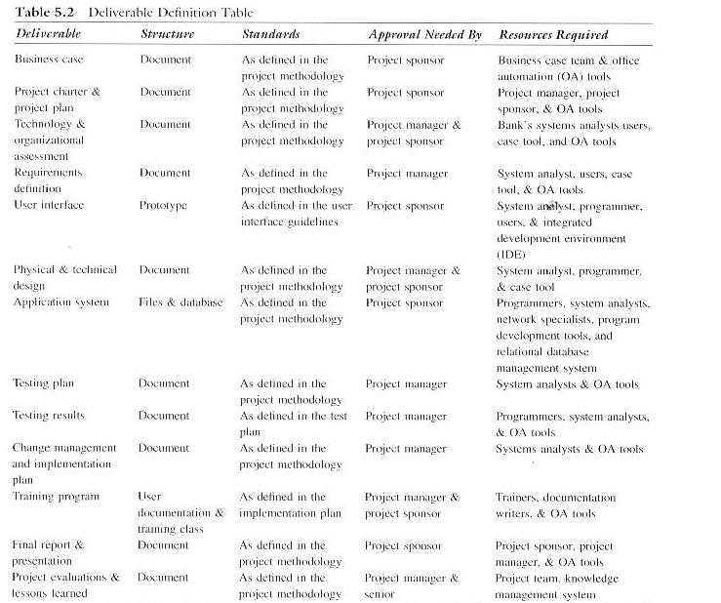
Deliverable Definition Table (DDT)

Slide 15
Deliverable
Structure
Chart

Slide 16
Scope
Product-Oriented Deliverables
What exactly is going to be delivered to the client? What does the system do?
Identifying the specific features and functionality of the application system to be delivered to the client are critical to time and budget estimation
Tools
Context Dataflow Diagram (DFD)
High-level representation of the system that has one process(circle) and depicts all the inflows and outflows of data and information between the system and external entities (squares).
Lower level DFDs will model the processes and flows in greater detail
Use Case Diagram (UCD)
Identifies main functions and features of the system and the different users and external systems that interact with it
Further refined and detailed during requirements analysis

Slide 17
Context Data
Flow Diagram

Slide 18
Scope
Use Case Diagram (UCD)
Identifies main functions and features of the system and the different users and external systems that interact with it
May be developed iteratively during joint application development (JAD) sessions
Further refined and detailed during requirements analysis
Actors – people (users, customers, managers, etc.) or external systems that interact or use the system
Use Case – depicts the major functions the system must perform for an actor or actors
The use case diagram shows a customer actor using the system to transfer payments.
In the requirements analysis, a set of scenarios would be developed to depict what happens when a transfer is successful, another when there are insufficient funds, etc.

Slide 19
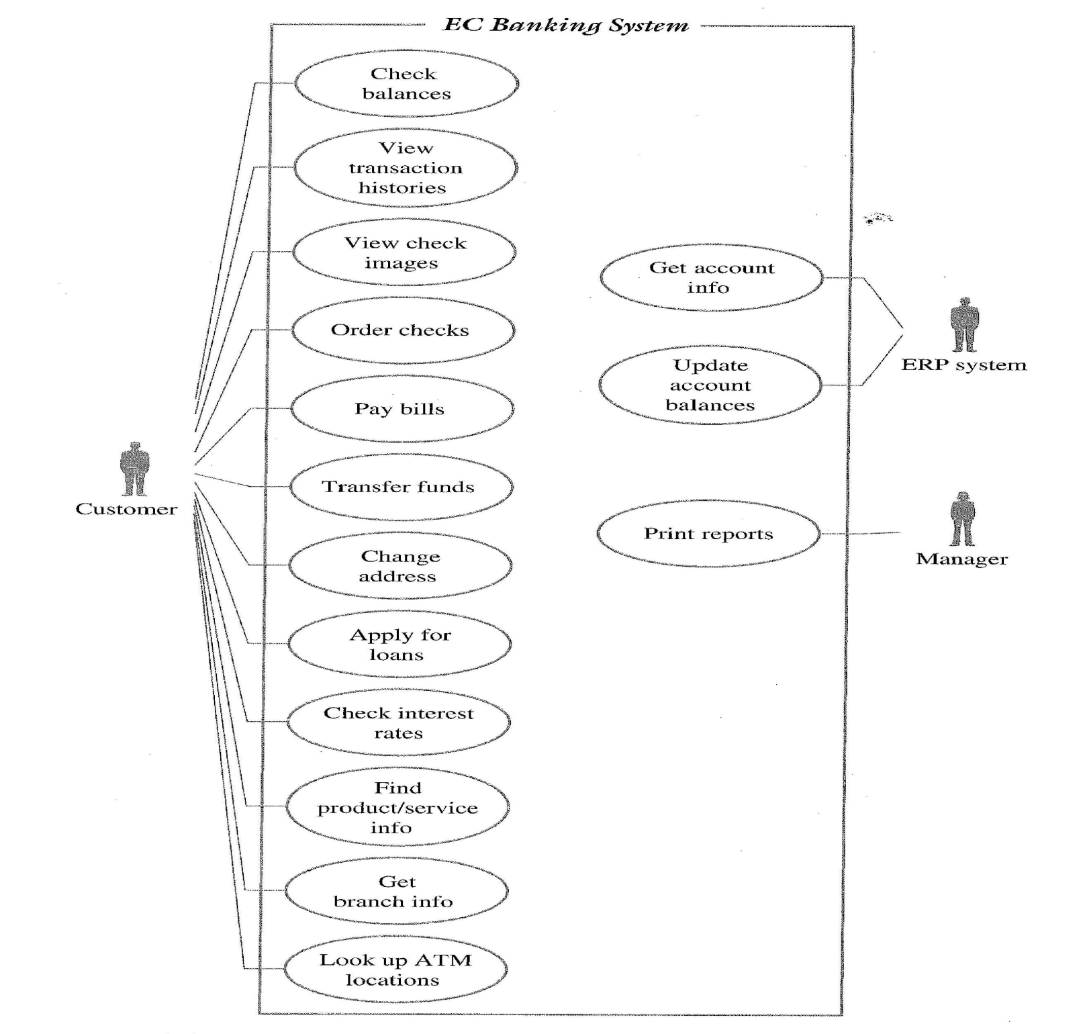
Use Case
Diagram

Slide 20
Project Scope Verification
Provides a mechanism for ensuring that the project deliverables are completed according to the DDT.
MOV
Has the project’s MOV been clearly defined and agreed upon? If not, scope changes may result later in the project.
Deliverables
Are the deliverables tangible and verifiable?
Do they support the project’s MOV?
Quality Standards
Will the work be completed to meet specific standards?
Milestones
Significant events that mark the acceptance of a deliverable
Tell that a deliverable was not only completed but reviewed and accepted
Review and Acceptance
Formal signoff by project stakeholders, plan sponsor and project team.

Slide 21
Scope Change Control
Concerned with managing changes to the project’s scope and to ensure that these changes are beneficial when they occur
Mitigates:
Scope Grope – project team’s inability to define the project scope. Use MOV as guidelines and follow scope processes and tools
Scope Creep – increasing featurism
Scope Leap – fundamental change in the project scope. New MOV may require killing of existing project and start of new one.
Tools/Procedures:
Scope Change Request Form
Scope Change Request Log

Slide 22
Scope Change Request Form
Requestor Name: _______________ Request Date: __________
Request Title: __________________ Request Number: _______
Request Description:
Justification:
Possible Alternatives:
Impacts
Alternative 1
Alternative 2
Alternative 3
Scope
Schedule
Resources Required
Cost
Recommendation:
Authorized By:
Date:

Slide 23
Scope Change Request Log

Slide 24

Benefits of Scope Control
Keeps the project manager in control of the project.
Authorized changes to the project’s scope are reflected in changes to the project’s schedule and budget.
Allows the project team to stay focused and on track
They do not have to perform unnecessary work.

